Slide 1
SQL SERVER ARCHITECTURE
Jan 2012

Slide 2
OVERVIEW
SQL architecture diagram
Components of SQL server engine
Protocols
The relational engine& its components
The storage engine & its components
The SQL OS & its components
Observing engine behavior
Observing SQL internals

Slide 3
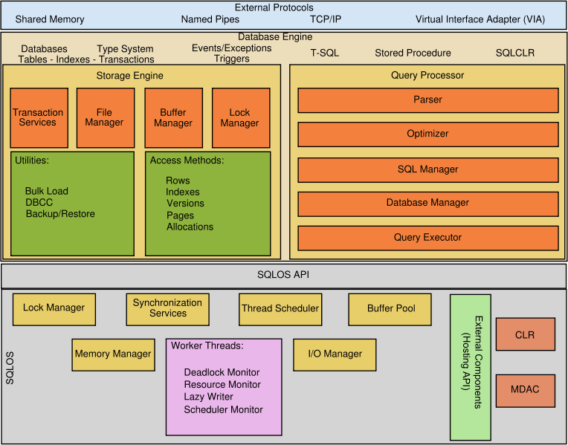
ARCHITECTURE DIAGRAM

Slide 4
COMPONENTS- WORKING
Protocols→Receives the request and translates it into a form that relational engine can work with. It also takes final result /status messages , translates them in to a form that client can understand.
Relational engine→Accepts T-SQL batches & determines what to do with them.
It parses, compiles & optimizes the request. If any data required, request passed to storage engine.
Storage engine→Manages all data access both through transaction based commands ,bulk operation and certain DBCC commands.
SQL OS→handles activities that are normally considered as OS responsibilities such as scheduling, deadlock detection ,memory management..

Slide 5
PROTOCOLS
Communication between DB engine and Application programming interfaces are exposed by protocol layer using Microsoft defined format called TABULAR DATA STREAM packet.
These TDS packets are encapsulated by SQL Server network interface layer on both server and client computers inside standard communication protocol like TCP/IP..
SQL allows you to create a TDS endpoint so that it listens on an additional TCP port.SQL automatically creates an endpoint for each protocol.
If the protocol is enabled all the users have access for it, if not, the endpoint still exists but cannot be used
SQL server can be configured to support multiple protocols simultaneously coming from different clients.

Slide 6
AVAILABLE PROTOCOLS
SHARED MEMORY→Simplest with no configurable settings. Allows the client to connect only to a SQL instance running on the same computer.
NAMED PIPES→ Developed for LANs . A portion of memory is used by one process to pass information to another process, so the output of one is input to other. Second process can be local or remote
TCP/IP→ Most widely used protocol over the internet. It can communicate across interconnected networks of computers with diverse H/W and OS system.
VIRTUAL INTERFACE ADAPTERS→ A protocol that works with VIA hardware. Specialized protocol for VIA only

Slide 7
RELATIONAL ENGINE/ QUERY PROCESSOR
COMPONENTS:
→Command parser
→Query optimizer
→Query executor
Relational engine manages execution of queries as it request data from the storage engine and processes the results returned.
Communication between the relational engine and storage engine is in terms of OLE DB row sets.
Command parser handles T_SQL language events to SQL server. It checks for syntax and translates them to internal format known as QUERY TREE.
Non syntax errors cannot be explicit about the source line. Reason is parser can access only source of the statement , when the command is actually executed, the statement is no longer available in source format

Slide 8
THE QUERY OPTIMISER & EXECUTOR
→It takes the query tree from command parser and prepares it for execution.
→Query optimization and compilation result in an execution plan.
First step in producing such a plan is to normalize each query which breaks down a single query into multiple queries. After this, it optimizes queries, which means it determines a plan for executing that query.
It is cost based which includes memory, CPU required I/Os.
Normalised+Optimized+Compiled= execution plan which is actually a data structure
The Query executor runs the execution plan that optimizer produces. Acting as a dispatcher for all the commands.
Most of the commands require interaction with storage engine to modify or retrieve data and to manage transactions and locking.

Slide 9
THE STORAGE ENGINE
Composed of three main areas:
→Access methods
→Locking and transaction services
Utility commands
Access methods :
When SQL SERVER needs to locate data, it calls the access methods code which
Sets up and scans of data pages and index pages
Prepares the OLEDB row sets to return to relational engine
Access methods code does not actually retrieve the pages ;
it makes the request to the buffer manager, serves up the page in its cache or reads it to cache from disk.

Slide 10
TYPES OF ACCESS METHODS
Row and index operations: Row operations code retrieves, modifies and performs an operations on individual rows i.e. within the row, such as “retrieve column 2” or “write this value to column 3”. Index operations code maintains and support searches on B-trees which has root page and intermediate level.
Page Allocation operations: Allocation operation code manages a collection of pages for each DB and keeps track of which pages in a DB have already been used, for what purpose they have been used and how much space is available on each page.
Versioning Operations: This was added in SQL Server 2005, i.e. access through the version store. Row versioning allows SQL server to maintain older versions of changed rows. Older versions of updated rows are kept in tempdb

Slide 11
TRANSACTION SERVICES
TRANSACTION PROPERTIES:
Atomicity– Transactions are all or nothing; either commits or aborts.
Consistency—Data must always be logically correct.
Isolation– Separates concurrent transactions from other updates automatically.
Durability—Ensures the effect of transaction persist even if a system failure occur.
CONCURRENCY MODEL:- Guarantee ACID properties of transactions
PESSIMISTIC:
Ensures correctness & consistency by locking data so that it cannot be changed. Prior to SQL 2005 used this model. Default in both SQL 2005 and SQL 2008.
OPTIMISTIC:
Uses row versioning to allow data readers to see the state of data before modifications occurs. High cost as SQL spend time in managing version store.
Read uncommitted, Repeatable read,serialiazable-→Pessimistic
Snapshot isolation→Optimistic; Default Read committed →Either

Slide 12
LOCKING OPERATIONS
Crucial function of a multi user DB system.
SQL server provides 2 separate locking systems.
First one affects all fully shared data provides rowlocks page locks, table locks for data pages, LOB& leaf level index pages.
Second system used internally for index ,concurrency control, controlling access to internal data structures & retrieving individual rows of data pages. It uses latches which is less resource intensive than locks.
Locks ensures the logical consistency of data whereas latches ensures physical consistency.
SQL server lets us to manage multi users simultaneously and ensures that transactions obey isolation property
Utility command is for handling bulk load, DBCC , backup and restore operations

Slide 13
THE SQL OS
It is a separate application layer at the lowest level of SQL server database engine.
Earlier versions of SQL server have thin layer of interfaces between the storage engine and actual OS through which SQL Server makes call to operating system for memory allocation, scheduler resources, thread management and synchronization objects.
Interfaces can be in any part of the engine. Rather than each part becoming complex,
a single application layer has been designed to manage all operating system resources that are specific to SQL Server
The two main functions of SQLOS architecture are
Scheduling
Memory management

Slide 14
THE SCHEDULER
Prior to SQL 7.0 , Windows scheduler was used
SQL7.0 and SQL 2000 used UMS for scheduling
SQL 2005 and 2008 uses SOS scheduler
SQL scheduler—Co-operative whereas Windows scheduler is preemptive.
Means it relies on worker threads to yield voluntarily so one process does not have exclusive control of the system.
A scheduler must adhere to the concept of quantum,
Instead of OS forcing a SQL server task to give up, SQL server itself put a request on wait queue periodically, if they have exceeded internally defined quantum & not in middle of task that can be stopped, they will voluntarily relinquish the CPU

Slide 15
Worker threads
Worker is a thread or fiber which is associated with a CPU.
Each scheduler is assigned to a worker limit based on the configured Max Worker Threads.
Each scheduler is responsible for creating and destroying the workers as needed.
When a scheduler receives a request, workers are created and there are no idle workers.
Worker can be destroyed if it has been idle for at least 15 min or if SQL server is under memory pressure.
Each worker can consume ½ MB of memory on 32-bit system and 2MB of memory on 64-bit system.
Removing the idle workers can yield an immediate performance improvement on memory starved systems

Slide 16
MEMORY MANAGEMENT
By default SQL server manages its memory resources almost completely dynamically.
When allocating memory, SQL must communicate constantly with Operating system which is one of the reasons the SQL OS layer of the engine is so important
BUFFER POOL :
Main memory component . Unused memory remains in buffer pool to be used as data cache for pages read in from database files on disk.
A Buffer is a page in memory that's the same size as a data or index page.
BUFFER MANAGER:
Buffer manager manages disk I/O functions for bringing data and index pages into the data cache so data can be shared among users.

Slide 17
Access to in-memory pages
Access to pages in data cache must be fast.
Hashing is a technique that uniformly maps a key via hash function across set of hash buckets.
Hash table is a structure in memory that contains array of pointers to buffer page.
If all pointers to buffer pages do not fit on a single page hash, a linked list of chains to all hash pages will be created
Dbid-fileno-pageno acts as a identifier.
Hash function converts the key to hash bucket.
The number of hash buckets is set internally by the SQL server and depend on the total size of the buffer pool
By using this technique, even a large amount of memory are present, SQL server can find a specific data page on cache with only few memory reads

Slide 18
Managing pages in the data cache
You can use a data page only if it exists, Therefore, buffer in data cache must be available for the pages to be read in.
Keeping a supply of buffer available for immediate use increases performance.
If buffer is not ready , many pages have to be searched.
Every buffer in data cache has a header that contains information about last 2 times a page was referenced.
Reference information uses an algorithm called LRU-K algorithm- Least recently used (LRU)replacement policy which has knowledge of how recently a page was used.
An LRU-K algorithm keeps track of the last K times a page was referenced and can differentiate between types of pages.
SQL 2008 uses K value of 2 so it keeps track of the two most recent accesses of each buffer pages

Slide 19
LAZY WRITER
Each instance of SQL server has a thread called Lazy Writer that scans through buffer cache.
It Sleeps for specific interval of time,
when it wakes up, it examines the size of the free buffer list, if the list is below threshold, Lazy writer scans buffer pool to repopulate the free list.
As the buffers are added to free list , they are also written to disk if they are dirty.
Lazy writer expands or shrink the data cache to keep OS free Physical memory at 5MB, if it is less than 5MB, Lazy writer releases memory to Operating system.
Lazy writer queries the system periodically to determine the amount of free physical memory available.

Slide 20
CHECKPOINT
Checkpoint scans the buffer cache periodically and writes any dirty data pages for particular database to disk.
Difference between the check point and lazy writer is checkpoint never puts buffer on free list.
The only purpose is to ensure that pages written before certain time are written to disk so dirty pages in memory is always minimum.
It also ensures length of time SQL server requires for recovery of database after a failure is kept to a minimum.
Check point are triggered
DB owner explicitly issue CHECK POINT command
Log is getting 70% full and DB is in auto truncate mode.
Long recovery time is estimated checkpoint are taken as recovery interval frequency.
Orderly SHUT DOWN without NO WAIT option

Slide 21
Managing Memory in other cache
Buffer pool memory that is not for data cache is used for other types of caches like plan cache.
SQL 2008 uses common frame work that is used by all caches except data cache.
This frame work consists of set of stores and resource monitor.
3 Types of stores: Cache store, User store, Object Stores
All these uses LRU mechanism to determine which pages can stay and which can be freed.
SQL Server implement two hands for managing memory in cache.
External: Implement global policies(Total memory on system)
Internal: Implement local policies(cache memory).
Resource monitor is in charge of moving external hands whenever it notices memory pressure.
The Internal clock moves whenever an individual caches needs to be trimmed

Slide 22
Memory Broker
Memory is needed by so many components in SQL server and to make sure each component uses memory efficiently, SQL Memory Broker is used
Memory broker’s job is to analyze SQL server memory consumption and to improve dynamic memory distribution.
Memory broker is a control mechanism with a feed back loop.
It monitors memory demand and consumption by component.
It broadcasts this data to the component which then uses the information to adapt its memory usage.
Select * from sys.dm_os_ring_buffers
Where ring_buffer_type='RING_BUFFER_MEMORY_BROKER‘
Ring buffer for the memory broker is updated only when the memory broker wants the behavior of a given component to change – that is to grow , shrink or remain stable.

Slide 23
DMVs- To check engine behavior
Dm_exec_*→contains information related to the execution of user code and associated connections. Eg:Sys.dm_exec_sessions
Dm_os_*→ contains low level system information such as memory, locking & scheduling. Eg: sys.dm_os_schedulers.
Dm_tran_*→contains details about current transactions.
Eg: sys.dm_tran_locks.
Dm_io_*→keeps track of I/O activity on networks and disks.
Eg: sys.dm_io_virtual file_stats
Dm_db_*→ contains details about databases and its objects.
Eg: sys.dm_db_index_physical_stats

Slide 24
DMVs-To check scheduler internals
Sys.dm_os_schedulers:
returns one row per scheduler in SQL server.
sys.dm_os_workers:
returns one row for every worker in the system
Sys.dm_os_threads:
returns list of all SQLOS threads under SQL server process
Sys.dm_os_tasks:
returns one row for each task that is active in the instance.
Sys.dm_os_waiting_tasks:
returns information about the queue of tasks that are waiting on some resource.

Slide 25
DMVs- To check Memory internals
Sys.dm_os_sys_info:
returns general purpose SQL server configuration data.
Sys.dm_os_memory_clerks:
Returns one row per memory clerk that is currently active in the instance.
Sys.dm_os_memory_cache_counters:
Returns a snapshot of the health of each cache of type user store and cache store.
Sys.dm_os_memory_cache_hash_tables:
Returns a row of each active cache in the instance

Slide 26
Thank you

